Slide 1
PROGRAMMING FOR PROBLEM SOLVING UNIT – 3 CONTROL STRUCTURE
SEMESTER: 1st
PREPARED BY: Prof. Brijesh Hansaliya

Slide 2
FOR LOOP
Loop Concept
Loop is a repetition for series of actions and activities.
In programming sometimes we need to repeat block or statement for some period.
Loop is helping to repeat particular block or set of statements for particular time period.
When to stop looping?
In chart , action is executed over and over again. It never stop – This is called an Infinite Loop
Solution – Put a condition to tell the loop either to continue or stop
An actions and activities or series of actions and activities

Slide 3
CONTINUE…
Main part of loop : Body and Condition
Body : Statement or Block of statements that will be repeated.
Condition : It is used to control iteration either to continue or stop the iteration.
Body Of Loop
True
Condition
False

Slide 4
PRE-TEST LOOP
Pre-test Loop (FOR LOOP)
Condition is tested First before start executing the body.
Body of the loop will executed if the condition is true.
If condition becomes false loop will terminate.
After executing body again condition is tested.
Condition
True
False
Body Of Loop
Stop

Slide 5
FOR LOOP
FOR Loop Flow Chart
The for loop in C language is used to repeat the statements or a block of the program several times.
The syntax of for loop in c language is given below:
for( Initialization ; Condition ; Increment or Decrement )
{
Statement block to be executed ;
}
Loop Execution :
Step 1: First initialization happens and the counter variable gets initialized. Execute only One time.
Step 2: In the second step the condition is checked, if the condition is true then the C statements inside the body of for loop gets executed, if the condition is false then the for loop gets terminated.
Step 3: After successful execution of statements inside the body of loop, the counter variable is incremented or decremented, depending on the operation (++ or –-).
Initialization
Condition
True
False
Statement
Incr / Decr
Stop

Slide 6
COMPARING FOR AND WHILE
WHILE LOOP
FOR LOOP
Initialize
for (
)
Initialize;
Condition;
While (Expression)
Increment or Decrement;
{
} /* While */
{
} /* For */
action
action
action
action
Continue…
Continue…
update counter
action

Slide 7
FOR LOOP EXAMPLE 1
i is initialized to 1.
The test expression i < 11 is evaluated. Since 1 less than 11 is true, the body of for loop is executed. This will print the 1 (value of i) on the screen.
The update statement ++i is executed. Now, the value of i will be 2. Again, the test expression is evaluated to true, and the body of for loop is executed. This will print 2 (value of i) on the screen.
Again, the update statement ++i is executed and the test expression i < 11 is evaluated. This process goes on until i becomes 11.
When i becomes 11, i < 11 will be false, and the for loop terminates.
// Print numbers from 1 to 10
#include <stdio.h>
int main() {
int i;
for (i = 1; i < 11; ++i)
{
printf("%d ", i);
}
return 0;
}
O / P :
1 2 3 4 5 6 7 8 9 10

Slide 8
FOR LOOP EXAMPLE 2
#include <stdio.h>
int main()
{ int num, count, sum = 0;
printf("Enter a positive integer: ");
scanf("%d", &num);
for(count = 1; count <= num; ++count)
{
sum += count;
}
printf("Sum = %d", sum);
return 0;
}
O/P :
Enter a positive integer: 5
Sum = 15
The value entered by the user is stored in the variable num. Suppose, the user entered 5.
The count is initialized to 1 and the test expression is evaluated. Since the test expression count<=num (1 less than or equal to 5) is true, the body of for loop is executed and the value of sum will equal to 1.
Then, the update statement ++count is executed and the count will equal to 2. Again, the test expression is evaluated. Since 2 is also less than 5, the test expression is evaluated to true and the body of for loop is executed. Now, the sum will equal 3.
This process goes on and the sum is calculated until the count reaches 6.
When the count is 6, the test expression is evaluated to false, and the loop terminates.
Then, the value of sum is printed on the screen.

Slide 9
VARIOUS FORMS OF FOR LOOP IN C
Suppose we are using variable num as the counter in all the following examples –
1) Here instead of num++, I’m using num=num+1 which is same as num++.
for (num=10; num<20; num=num+1)
2) Initialization part can be skipped from loop as shown below, the counter variable is declared before the loop.
int num=10;
for ( ; num<20;num++)
Note: Even though we can skip initialization part but semicolon (;) before condition is must, without which you will get compilation error.
3) Like initialization, you can also skip the increment part as we did below. In this case semicolon (;) is must after condition logic. In this case the increment or decrement part is done inside the loop.
for (num=10; num<20; )
{ //Statements
num++;
}

Slide 10
CONTINUE….
4) This is also possible. The counter variable is initialized before the loop and incremented inside the loop.
int num=10;
for (;num<20;)
{
//Statements
num++;
}
5) As mentioned above, the counter variable can be decremented as well. In the below example the variable gets decremented each time the loop runs until the condition num>10 returns false.
for(num=20; num>10; num--)

Slide 11
NESTED LOOPS IN C
C supports nesting of loops. Nesting of loops is the feature that allows the looping of statements inside another loop.
Any number of loops can be defined inside another loop, i.e., there is no restriction for defining any number of loops. The nesting level can be defined at n times.
Syntax for Nested Looping :
Outer_loop
{
Inner_loop
{
// inner loop statements.
}
// outer loop statements.
}

Slide 12
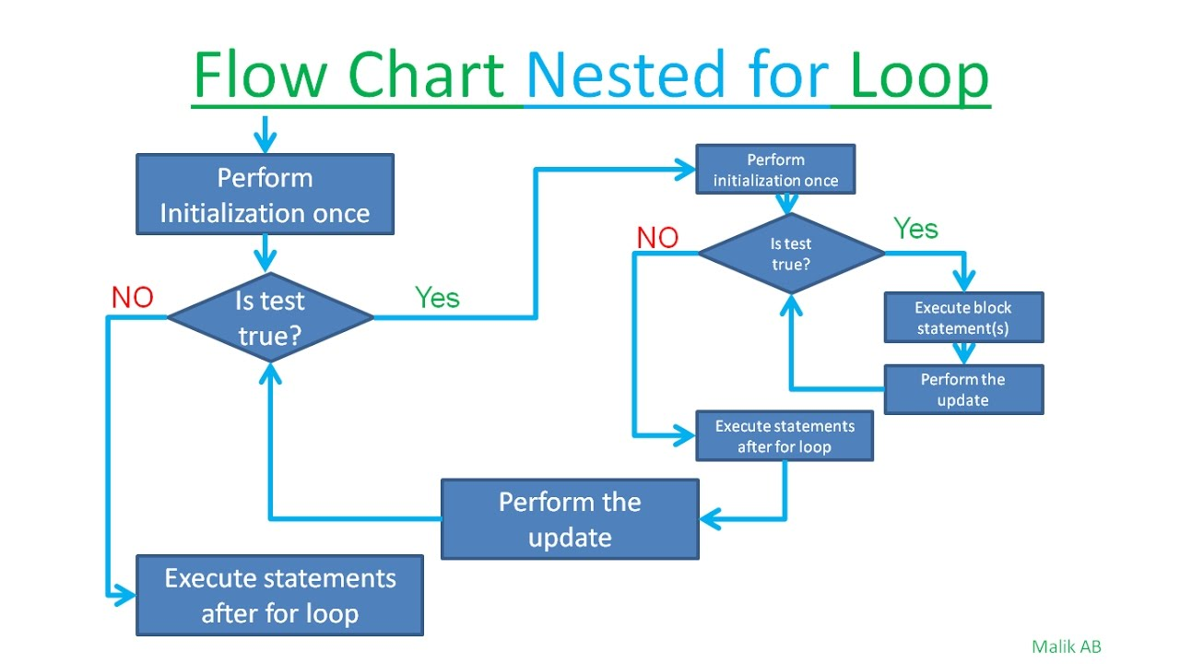
NESTED FOR LOOP
The nested for loop means for loop which is defined inside the another 'for' loop.
for (initialization; condition; increment or decrement)
{
for(initialization; condition; increment or decrement)
{
// inner loop statements.
}
// outer loop statements.
}
Nested For loop Flow Chart :

Slide 13
NESTED FOR LOOP EXAMPLE
#include <stdio.h> int main(void) { int i,j; for(i=0;i<5;i++)
{ for(j=0;j<=i;j++) { printf(" *"); } printf("\n"); } return 0; }
O/P : *
* *
* * *
* * * *
* * * * *
First, the 'i' variable is initialized to 1 and then program control passes to the i<5.
The program control checks whether the condition 'i<5' is true or not.
If the condition is true, then the program control passes to the inner loop.
The inner loop will get executed until the condition is true.
After the execution of the inner loop, the control moves back to the update of the outer loop, i.e., i++.
After incrementing the value of the loop counter, the condition is checked again, i.e., i<5.
If the condition is true, then the inner loop will be executed again.
This process will continue until the condition of the outer loop is true.

